Slide 1
Analysis of Protein Purity
Total protein
Specific quantification
  Activity assays
  Binding assays
Detection of impurities
  HPLC
  Gel electrophoresis
Protein mass spectrometry

Slide 2
Monitoring Progress of Purification Protocol
Total protein (mg)
  Quantity of protein present in fraction
Total activity (units of activity)
  Use a portion of sample to determine activity.
  Multiply activity by total volume to determine total activity.

Slide 3
Monitoring Progress of Purification Protocol
Specific activity (units of activity/mg)
  Total activity
  Total protein
% yield: measure of activity retained after each step in procedure.
S.A. =
  Total activity at particular step
  Total activity of initial extract
% yield =

Slide 4
Monitoring Progress of Purification Protocol
Purification level: Measure of increase in purity of protein throughout procedure.
Purification =
  Specific activity at particular step
  Specific activity of initial extract

Slide 5
Monitoring Progress of Purification Protocol
Step | Total protein (mg) | Total activity (units) | Specific activity (units/mg) | Yield (%) | Purification level
Initial extract | 15,000 | 150,000 | 10 | 100 | 1
(NH₄)₂SO₄ precipitation | 4,600 | 138,000 | 30 | 92 | 3
Ion-exchange | 1,278 | 115,500 | 90 | 77 | 9
Size exclusion | 68.6 | 75,000 | 1,100 | 50 | 110
Affinity column | 1.75 | 52,500 | 30,000 | 35 | 3,000

Slide 6
The Quantity of Protein
Bradford method to quantify the amount of protein.
F1, F2, F3 are diluted to 10, 100, 1000 and 10000 times.
100 μg/mL standard BSA solution is diluted to 50 μg/mL and 25 μg/mL to build the calibration curve.
Each fraction of protein dilution will be mixed with Bradford reagent to quantify the amount of protein.

Slide 7


Dilution Sequence
Protein Standard

Slide 8
Sucrose
A bag of sugar can be stored for years with very little conversion to CO₂ and H₂O
  This conversion is basic to life
  When consumed is converted to chemical energy very fast

Slide 9
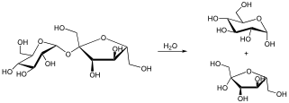
Catalysis
Carried out by very highly specialized class of proteins: Enzymes
  Specialized to perform specific chemical reactions
  Specialized to work in specific environments
H⁺
or Enzyme

Slide 10
Enzyme Kinetics
An approach to understanding the mechanism of action of enzymes
An approach to understanding how mutations may effect function
An approach to understand how changes in the physical and chemical environments change function

Slide 11
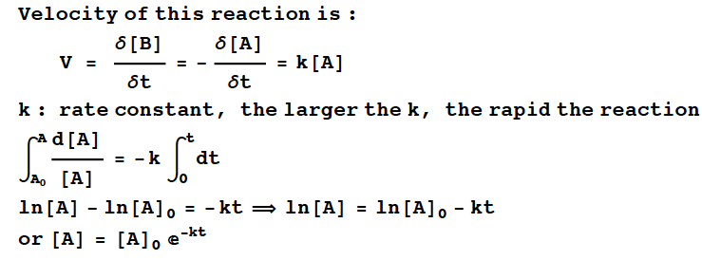
First Order Reaction

Slide 12
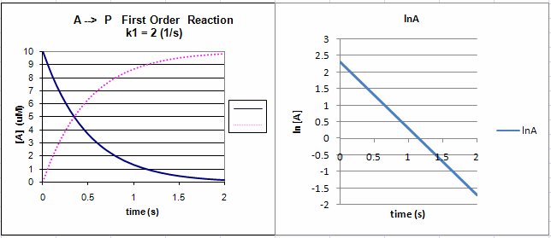
1st Order Reaction

Slide 13
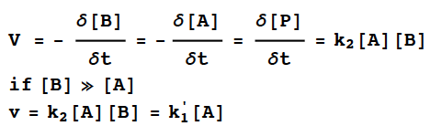
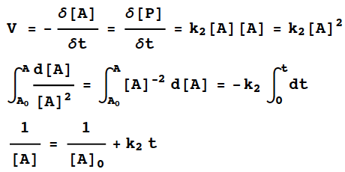
2nd Order Reaction

Slide 14
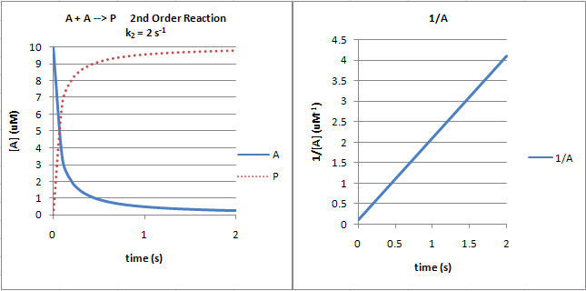
2nd Order Reaction

Slide 15
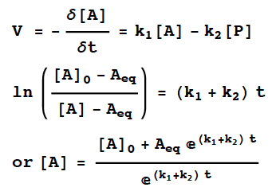
Reversible 1st Order Reaction

Slide 16
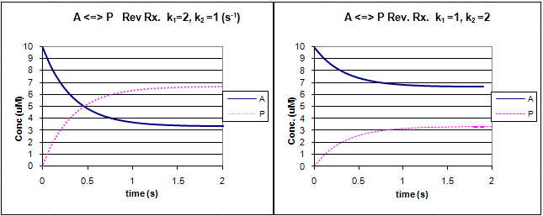
Reversible 1st Order Reaction

Slide 17
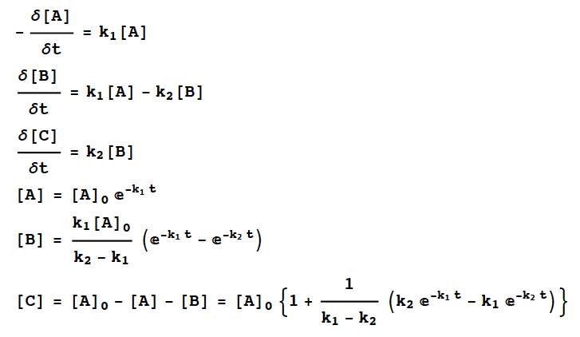
Consecutive 1st Order Reaction

Slide 18
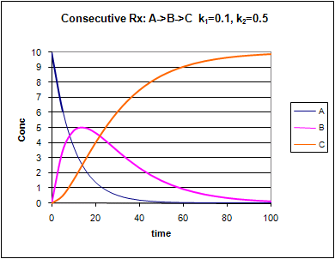
Consecutive 1st Order Reaction

Slide 19

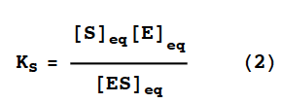

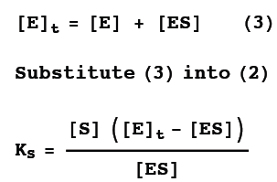
Rapid Equilibrium Assumption

Slide 20
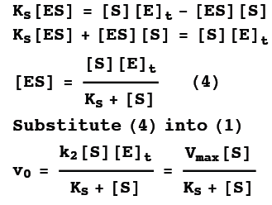
Henri-Michaelis-Menten Equation

Slide 21
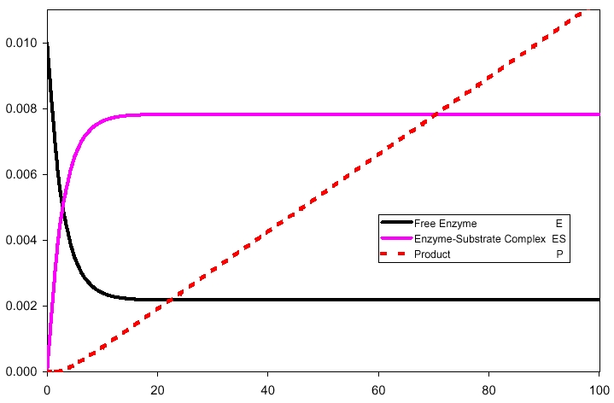
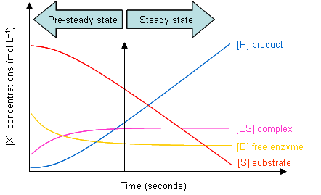
Steady-State Assumption

Slide 22
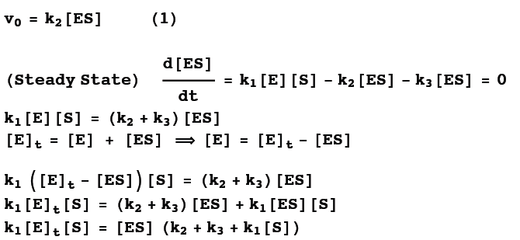
Steady-State Assumption

Slide 23
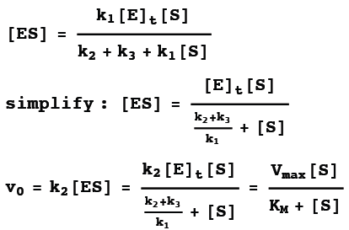
Michaelis-Menten Equation

Slide 24
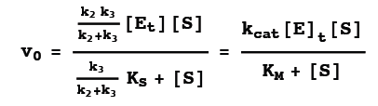

More Complicated Equation

Slide 25



Enzyme Kinetic Summary
Rapid Equilibrium
Steady-State
More Complicated

Slide 26
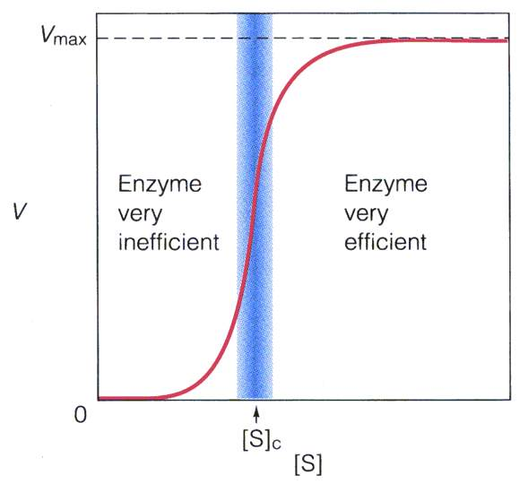
Effect of [Substrate]

Slide 27
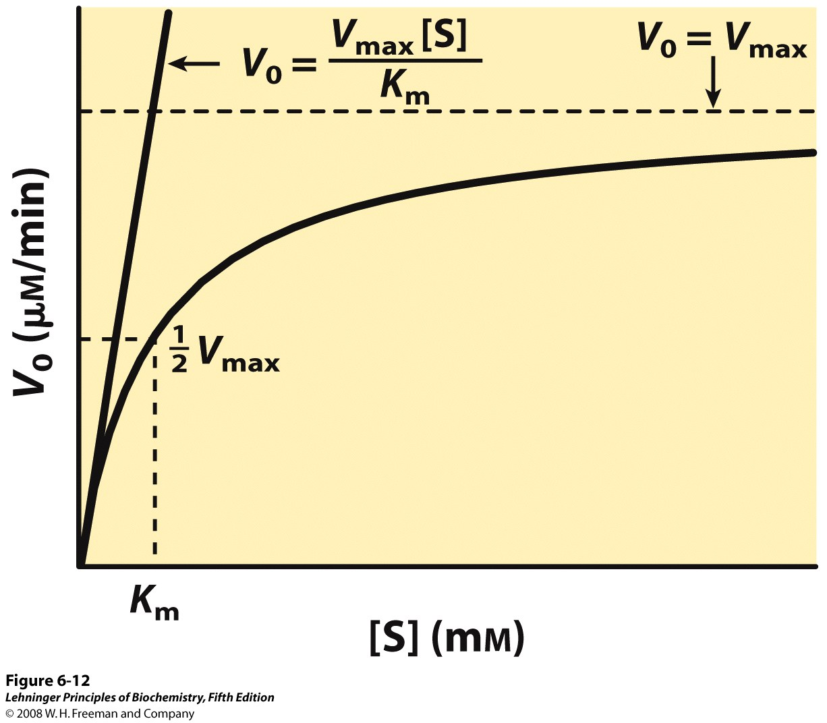
Notes:
FIGURE 6-12 Dependence of initial velocity on substrate concentration. This graph shows the kinetic parameters that define the limits of the curve at high and low [S]. At low [S], K_{m} >> [S] and the [S] term in the denominator of the Michaelis-Menten equation (Eqn 6-9) becomes insignificant. The equation simplifies to V₀ = V_{max}[S]/K_{m} and V₀ exhibits a linear dependence on [S], as observed here. At high [S], where [S] >> K_{m}, the K_{m} term in the denominator of the Michaelis-Menten equation becomes insignificant and the equation simplifies to V₀ = V_{max}; this is consistent with the plateau observed at high [S]. The Michaelis-Menten equation is therefore consistent with the observed dependence of V₀ on [S], and the shape of the curve is defined by the terms V_{max}/K_{m} at low [S] and V_{max} at high [S].

Slide 28
Effect of Enzyme

Slide 29
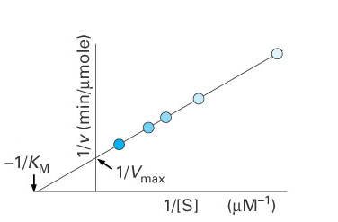
Determining K_{M} and V_{max}
Lineweaver-Burk (Double Reciprocal Plot)
Slope = K_{M} / V_{max}
o

Slide 30
Hanes-Wolff Plot
More conveniently, the MM equation can be plotted as a linear plot by rearranging the expression above to:
[S]/v
Slope=1/v_{max}
-K_{m}
K_{m}/v_{max}
[S]
Hanes-Wolff Plot

Slide 31
V_{max} and K_{M}
V_{max} is limited by
  Time required for product to be released
  How many E molecules are present
K_{M} gives an idea about affinity
  ↑K_{M} ↓substrate affinity
  ↓K_{M} ↑substrate affinity

Slide 32
Meaning of K_{m}
An important relationship that can be derived from the Michaelis-Menten equation is the following: If v_{o} is set equal to 1/2 V_{max}, then the relation V_{max} /2 = V_{max}[S]/K_{m} + [S] can be simplied to K_{m} + [S] = 2[S], or K_{m} = [S]. This means that at one half of the maximal velocity, the substrate concentration at this velocity will be equal to the K_{m}. This relationship has been shown experimentally to be valid for many enzymes much more complex in regards to the number of substrates and catalytic steps than the simple single substrate model used to derive it.

Slide 33
Meaning of K_{m} (cont)
The significance of K_{m} will change based on the different rate constants and which step is the slowest (also called the rate-limiting step). In the simplest assumption, the rate of ES breakdown to product (k₂) is the rate-determining step of the reaction, so k₋₁ >> k₂ and K_{m} = k₋₁/k₁. This relation is also called a dissociation constant for the ES complex and can be used as a relative measure of the affinity of a substrate for an enzyme (identical to K_{d}). However if k₂ >> k₋₁ or k₂ and k₋₁ are similar, then K_{m} remains more complex and cannot be used as a measure of substrate affinity.

Slide 34
Uses of K_{m}
Experimentally, K_{m} is a useful parameter for characterizing the number and/or types of substrates that a particular enzyme will utilize. It is also useful for comparing similar enzymes from different tissues or different organisms. Also, it is the K_{m} of the rate-limiting enzyme in many of the biochemical metabolic pathways that determines the amount of product and overall regulation of a given pathway. Clinically, K_{m} comparisons are useful for evaluating the effects mutations have on protein function for some inherited genetic diseases.

Slide 35
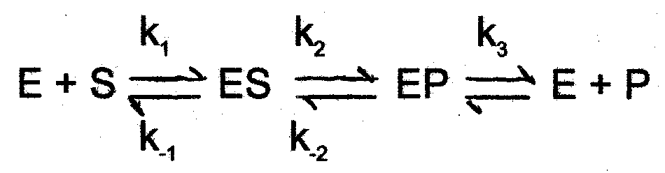
Meaning of V_{max}
The values of V_{max} will vary widely for different enzymes and can be used as an indicator of an enzymes catalytic efficiency. It does not find much clinical use.
There are some enzymes that have been shown to have the following reaction sequence:
In this situation, the formation of product is dependent on the breakdown of an enzyme-product complex, and is thus the rate-limiting step defined by k₃.

Slide 36
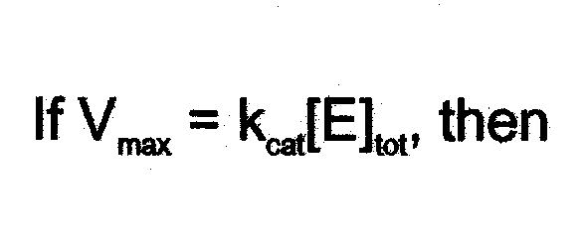
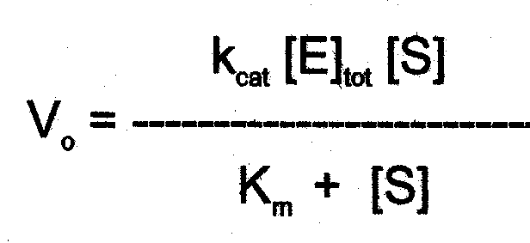
Derivation of k_{cat}
A more general term has been defined, termed k_{cat}, to describe enzymes in which there are multiple catalytic steps and possible multiple rate-limiting steps. The Michaelis-Menten equation can be substituted with k_{cat}

Slide 37
Definition and Use of k_{cat}
The constant, k_{cat} (units of sec⁻¹), is also called the turnover number because under saturating substrate conditions, it represents the number of substrate molecules converted to product in a given unit of time on a single enzyme molecule. In practice, k_{cat} values (not V_{max}) are most often used for comparing the catalytic efficiencies of related enzyme classes or among different mutant forms of an enzyme.

Slide 38
Purification Result

